Slide 1
Small Fusion Reactors
Dennis Whyte
MIT – Plasma Science and Fusion Center

Slide 2
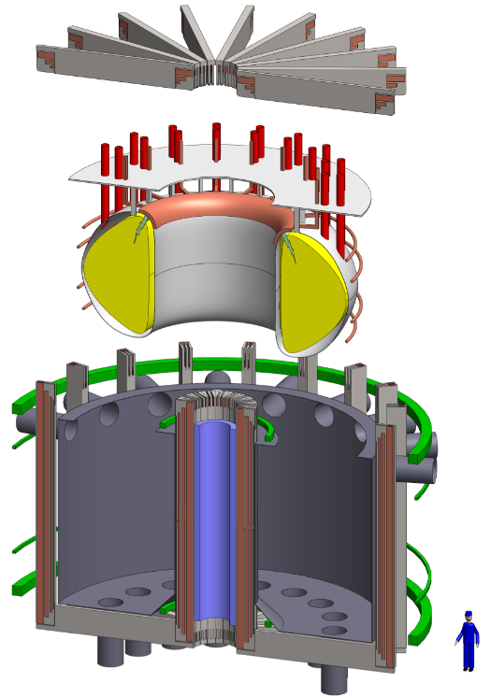
Fusion’s development would be accelerated by decreasing reactor unit size
Scaling present fission and ITER costs, the standard ~1000 m³ volume, 1000 MW fusion device will cost $20-30 Billion “per try”.
But…New superconducting materials may allow roughly doubling the magnetic field strength and magnet coils which can be “opened”.
5-10 fold decrease in device volume to ~100 m³ yet maintain high energy gain.
Easier and faster access to replace smaller-size internal components.
Costs decrease to less than $5 Billion for attractive 200 MW pilot fusion plant.
Small reactor “opened”
up for maintenance

